Slide 1
Lab session 11. Red black tree
KAMIL SALAKHIEV

Slide 2
Red black
Node is red or black
If node is red then both its children are black
All leves (NIL = NULL) are black
What about root ?

Slide 3

Red black. Example

Slide 4

Red black. Example

Slide 5
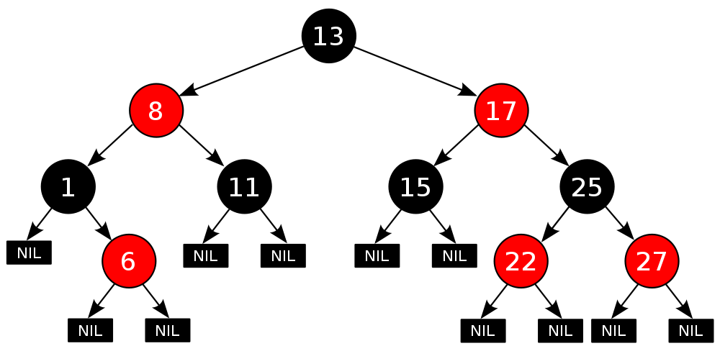
Full example

Slide 6
Balancing property
Path from root to any leaf should include the same number of black nodes
Are RB trees are always balanced in terms of AVL tree??

Slide 7
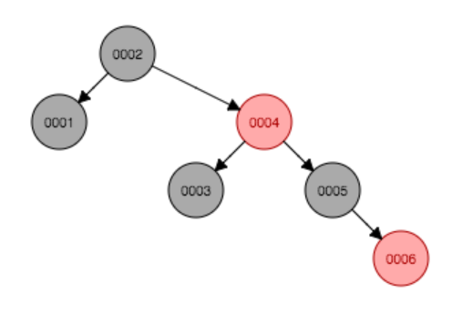
Balancing property

Slide 8
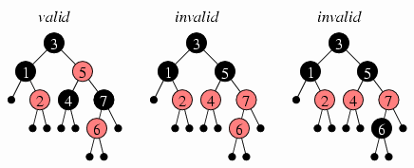
Valid or invalid ?

Slide 9
Valid or invalid ?

Slide 10
Valid or invalid ?

Slide 11
Valid or invalid ?

Slide 12
Valid or invalid ?

Slide 13
Valid or invalid ?

Slide 14
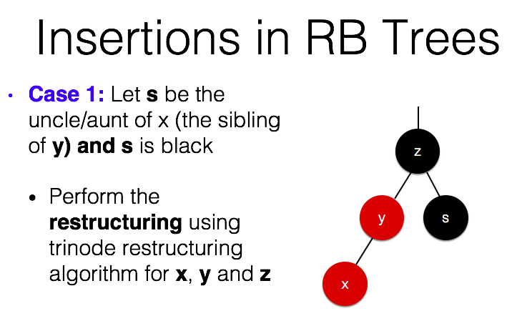
From the lecture: valid or invalid?

Slide 15
Insertion
Add black node if tree is empty
Add red node otherwise

Slide 16
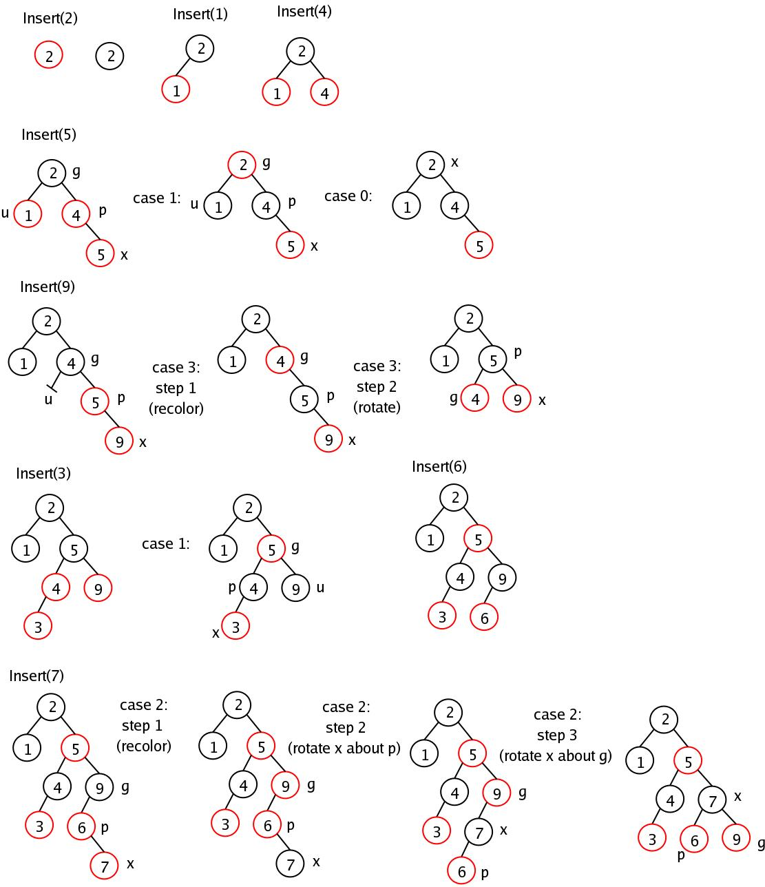
Insertion. Parent is black

Slide 17
Insert 5 now

Slide 18
Parent – uncle red

Slide 19
Parent is red uncle is black

Slide 20
Insertion

Slide 21
Insertion

Slide 22
Insertion

Slide 23
Insertion

Slide 24
One more example
Insert 4 here

Slide 25
One more example
Mark inserted node as “x” and its uncle as “y”

Slide 26
One more example
Switch colors of parent, uncle and grandparent

Slide 27
One more example
Again double red problem. Mark 7 as “x” and its uncle 14 as “y”. Here we are supposed to perform “big right rotation” around node 11

Slide 28
One more example
Perform left rotation around node 2

Slide 29
One more example
Change color of 7 and 11 and perform right rotation around node 11

Slide 30
One more example

Slide 31
One more example

Slide 32
Delete
Replace deleted node with in-order successor/predecessor that has at most one child (always).

Slide 33
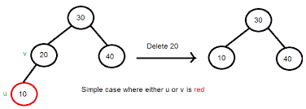
Delete. Simple case

Slide 34
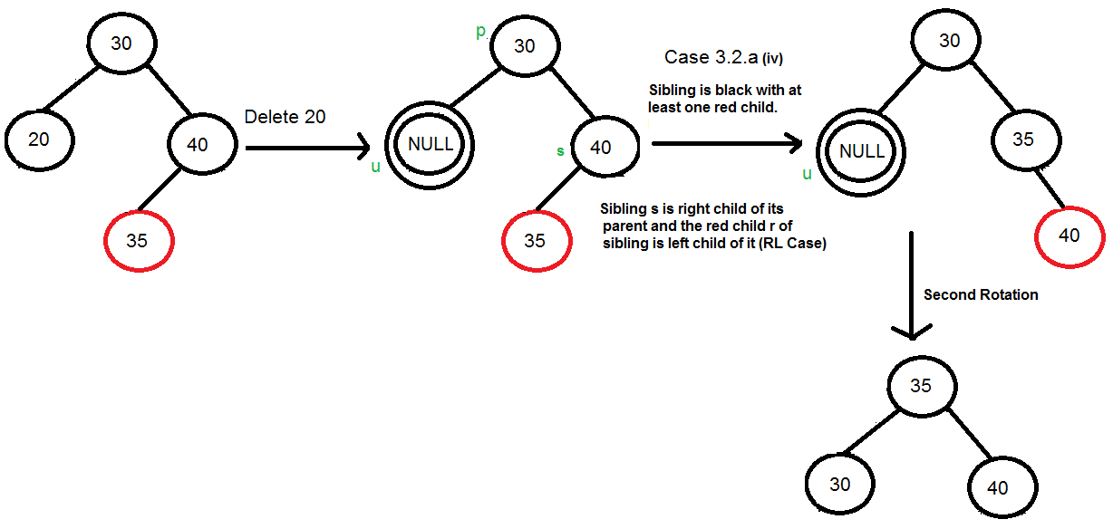
Delete. Hard case

Slide 35
Delete. Harder case

Slide 36
Delete. Harder case

Slide 37
Task for today
1) Implement Red-Black node class.
2) Implement “uncle” and “grandparent” methods.
3) Implement insertion operations for RB-tree.

Slide 38
Bonus task
4) (*) Measure algorithm complexity properties.
Insert 1000000 (1M) values from 0 to 999999 into the tree.
For each insertion, measure operation time and tree height.
Build 2 graphs that show operation time and tree height depending on number of elements in a tree. Do they fit O(log n) estimation?
Compare to AVL tree measurement on the same graph.
Create a report in LaTeX and send PDF to TA.

